Slide 1
S-100 Validation Tests sub group
1st VTC Meeting
26th April 2023

Slide 2
Meeting protocol
Meeting participants are kindly requested to note the following meeting protocols;
Please keep your camera and microphone turned “off” if you are not talking or presenting
If you want to make an intervention, please turn your camera and microphone on and, raise your hand to indicate that you wish to speak
Don’t forget to turn your microphone “on” before speaking, and “off” when finished
Please use the “Chat” function to communicate an text information to the meeting
If you have any problems connecting using Firefox or other browser – please try using Chrome.

Slide 3
welcome
Welcome to the 1st S-100 Validation Tests sub working group VTC
Background:
Sub group formed in December 2022 and a half day workshop was held at S-100 WG 7 meeting in Monaco
Initial tasks identified
Liz Hahessy (S-100 WG vice chair) with Yong Baek (IHO)
HSSC Action 14/15:
“HSSC noted the slow progress on the development of a harmonized data validation process and associated catalogues across the S-100 framework and agreed on the establishment of a dedicated subgroup”
1st VTC meeting – initial discussions on how to proceed and who needs to be involved
We have a mix of people, some who were at S-100 WG7 and others not
S-100 WG member states, expert contributors from industry and TWCWG members

Slide 4
AGENDA
Background
Summary of S-100 WG7 Validation Tests Workshop (December 2022)
Summary of S-100 Test Strategy Meeting 9 (March 2023)
Scope of group / what do we want to achieve?
Current status and agree on tasks
Challenges
Discussion about the way forward of the group
Future sub group meetings

Slide 5
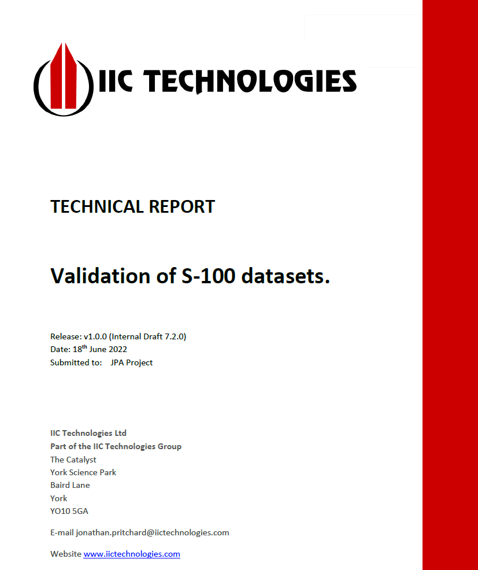
BackgrouND – S-100 WG7 Workshop
Workshop held in December
Presented summary of IIC report from 2022
Discussion regarding defining ‘validation’
Different users have different perspectives
Initial work based on ENCs as we have published documentation but need to think more broadly.
Important to involve more people across WGs and expert contributors
Validation diagram & table
Proposed initial format of validation tests
https://iho.int/uploads/user/Services%20and%20Standards/S-100WG/S-100WG7/S100WG7-8.1_2022_EN_Validation%20Tests%20v7.3.0_Draft.pdf

Slide 6
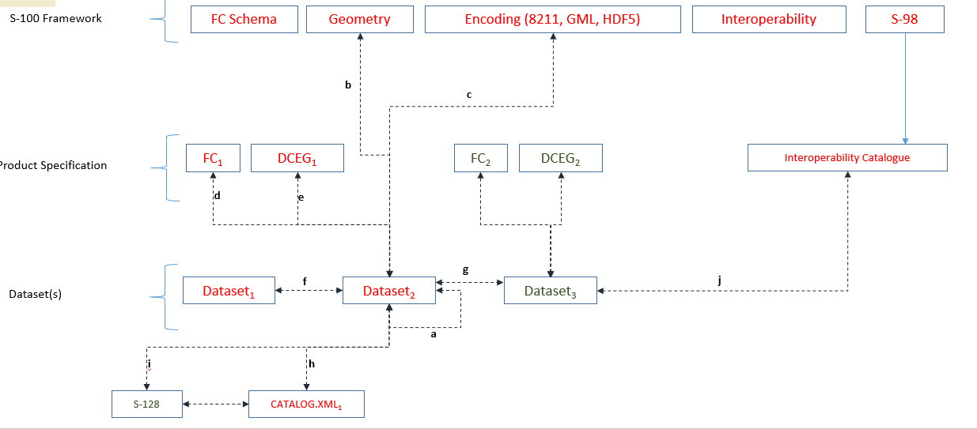
BackgrouND – S-100 WG7 Workshop
Missing:
Portrayal Catalogue
Validation between different versions of Product Specifications

Slide 7
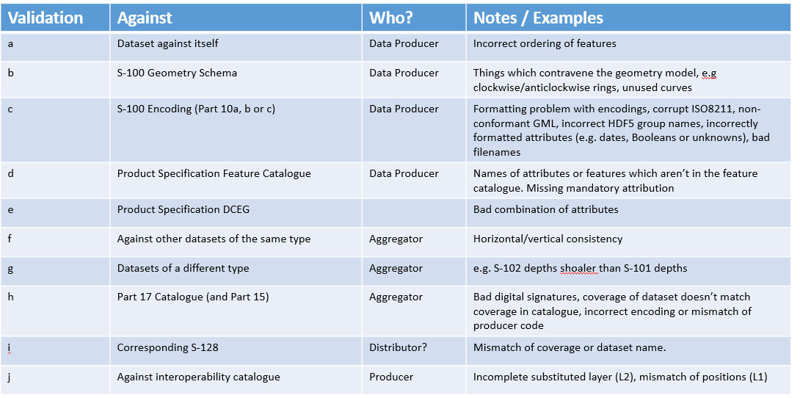
BackgrouND – S-100 WG7 Workshop
Responsibilities:
Who writes & maintains the different types of validation
Aggregator = RENC/VAR/Distributor. Potentially change to Service Provider

Slide 8
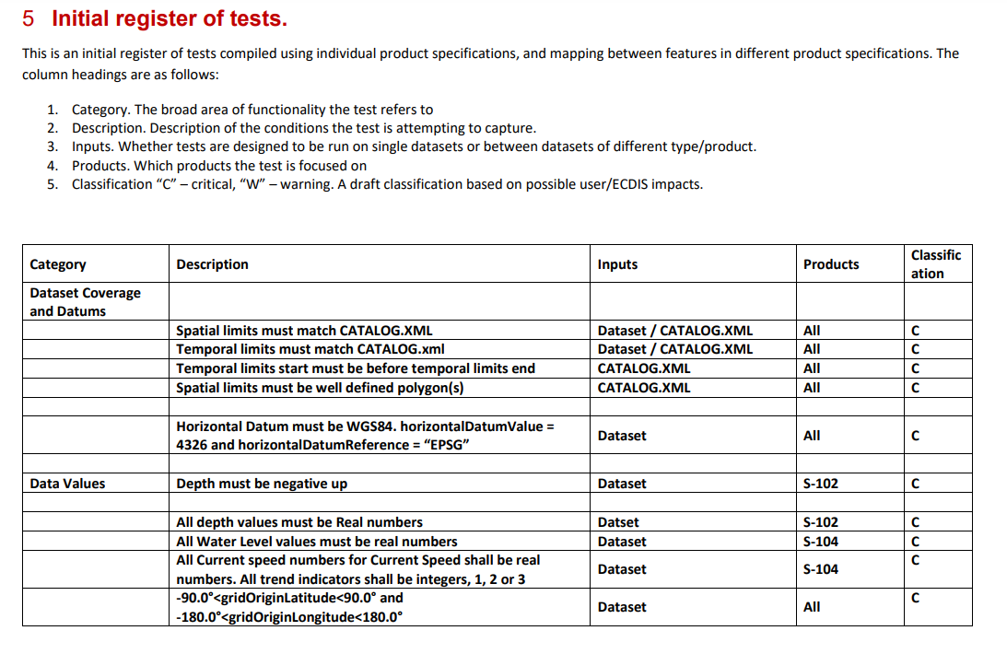
Proposed structure for tests
Propose adding Standard/document to refer to
Categories:
Dataset Coverage and Datums
Data Values
Coverage
Grid Structure
Resolution
Dataset Metadata
Cross Validation

Slide 9
Summary of S-100 WG7 Validation Tests Workshop (December 2022)
Takeaways
Scope :
Focus on framework level validation (Between PS will likely be S-98 but can capture for now)
Focus on ‘navigation only’ for now
Language and terminology important
Different timescales for different product specifications
Need to update diagram & table - different PS versions, Portrayal Catalogue missing, review discrepancies between table and diagram
Discussion about producing a data flow diagram showing where validation takes place
Define what ‘acceptable’ is
Agreed to use proposed ‘Structure for tests’

Slide 10
Summary of S-100 Test Strategy Meeting 9 (March 2023)
Reviewed progress to date
Discussed resource issues at beginning of year, especially with delivery of S-164 Edition 1
Agreed on task list
Timeline is a low priority – primarily use IHO timeline
Expected to have a draft Edition 1.0.0 delivery for S-100 WG 8 meeting in November (13-17th)
Recommended to contact Validation software manufacturers directly
Look to arrange physical side meeting during S-101 PT meeting in Brest, France June 2023
Unfortunately this was unsuccessful this time.

Slide 11
Scope
Deliverable will be a document with S-100 framework level validation tests, that affect some/all Product Specifications and Services, containing:
Explanatory text section including diagram & table
List of validation tests – need input from other groups
Not yet determined if it will be a separate standard (S-158?) or an Annex to another document (potentially S-100 or S-98)
Aiming for draft Edition 1.0.0 by S-100 WG8 (November)
Expect will be added to as more Product Specifications reach validation tests stage
Focus on the first stage of S-1xx products – navigation only

Slide 12
scope
What this group does not cover:
Does not identify/write Product Specification validation tests
Does not identify/write ECDIS Test Data Sets(S-164)
Does not make test data sets at this stage?
But there is overlap.
Cross over between validation specifications and groups
e.g. some items may need recording in individual PS validation tests, S-98, S-164, S-100 Validation, WEND & S-128
Help identify people who are working on similar tasks in different WGs.

Slide 13
S-100 validation tests – current status
Completed tasks:
Formed sub WG
Agreed to use proposed structure for tests, amend if required
Established GitHub page
GitHub - iho-ohi/S-100-Validation-Checks: S-100 Github repository for Validation Check development.
Update to S-100 TSM meeting
Contacted S-104 & S-111 Chairs – first to reach Edition 2.0.0
Received potential S-100 validation tests from S-101 & S-129

Slide 14
Tasks to do:
Task | Who | When Due
Populate GitHub pages with relevant information | Liz | End April
Produce work plan | Liz | End May
Contact validation software manufacturers | Liz | End May
Review DQWG documentation & contact DQWG chair |  | End May
Contact Test Bed owners to provide input | Liz | End May
Contact other PS owners, in particular S-102 & NIPWG chair. Ask for input. | Liz | End May
Updating draft S-100 Validation diagram and table | Liz & JP initially and then to group | End May
Identify different types of validation & who is responsible for them | Liz & JP initially and then to group | Before summer
Start looking at structure of Standard/ Annex document |  | Draft due Nov 2023
Request to HSSC for designated home for S-100 Validation (own specification or annex) | S-100 WG Chair | June 2023
Reviewing S-101 & S-129 validation test for inclusion in S-100 validation tests | Liz & Bruno to review initially but then to group | Ongoing
Potentially produce a data flow diagram showing where validation takes place | - | -
Potentially produce timeline, if necessary. If do it will be focused on when validation tests are due for different PS | - | -
Review S-100 sections to see if there are items that will require validation | - | -
Raising profile and asking relevant groups to submit potential tests | Group | Ongoing

Slide 15
S-100 validation tests – CHALLENGES
Need to get engagement across working groups and product specifications
Who is missing and should be included?
NIPWG, S-102
Not always easy to find information or contacts
Crossover between validation specifications and groups
Terminologies across different product specifications
Limited resources

Slide 16
Future sub group meetings
How do we want to hold these meetings?
Is correspondence sufficient or do we need a physical meeting?
If we require a physical meeting, can we conduct it as a side meeting at another meeting?
Amount of notice required to hold physical meeting?
Agreed that a significant portion at S-100 WG 8 will be devoted to S-100 Validation Tests (November 2023 – Singapore)
VTC – how frequent? Monthly/ Every 2 months?
For how long and at what time?
What do we want on GitHub?

